Slide 1
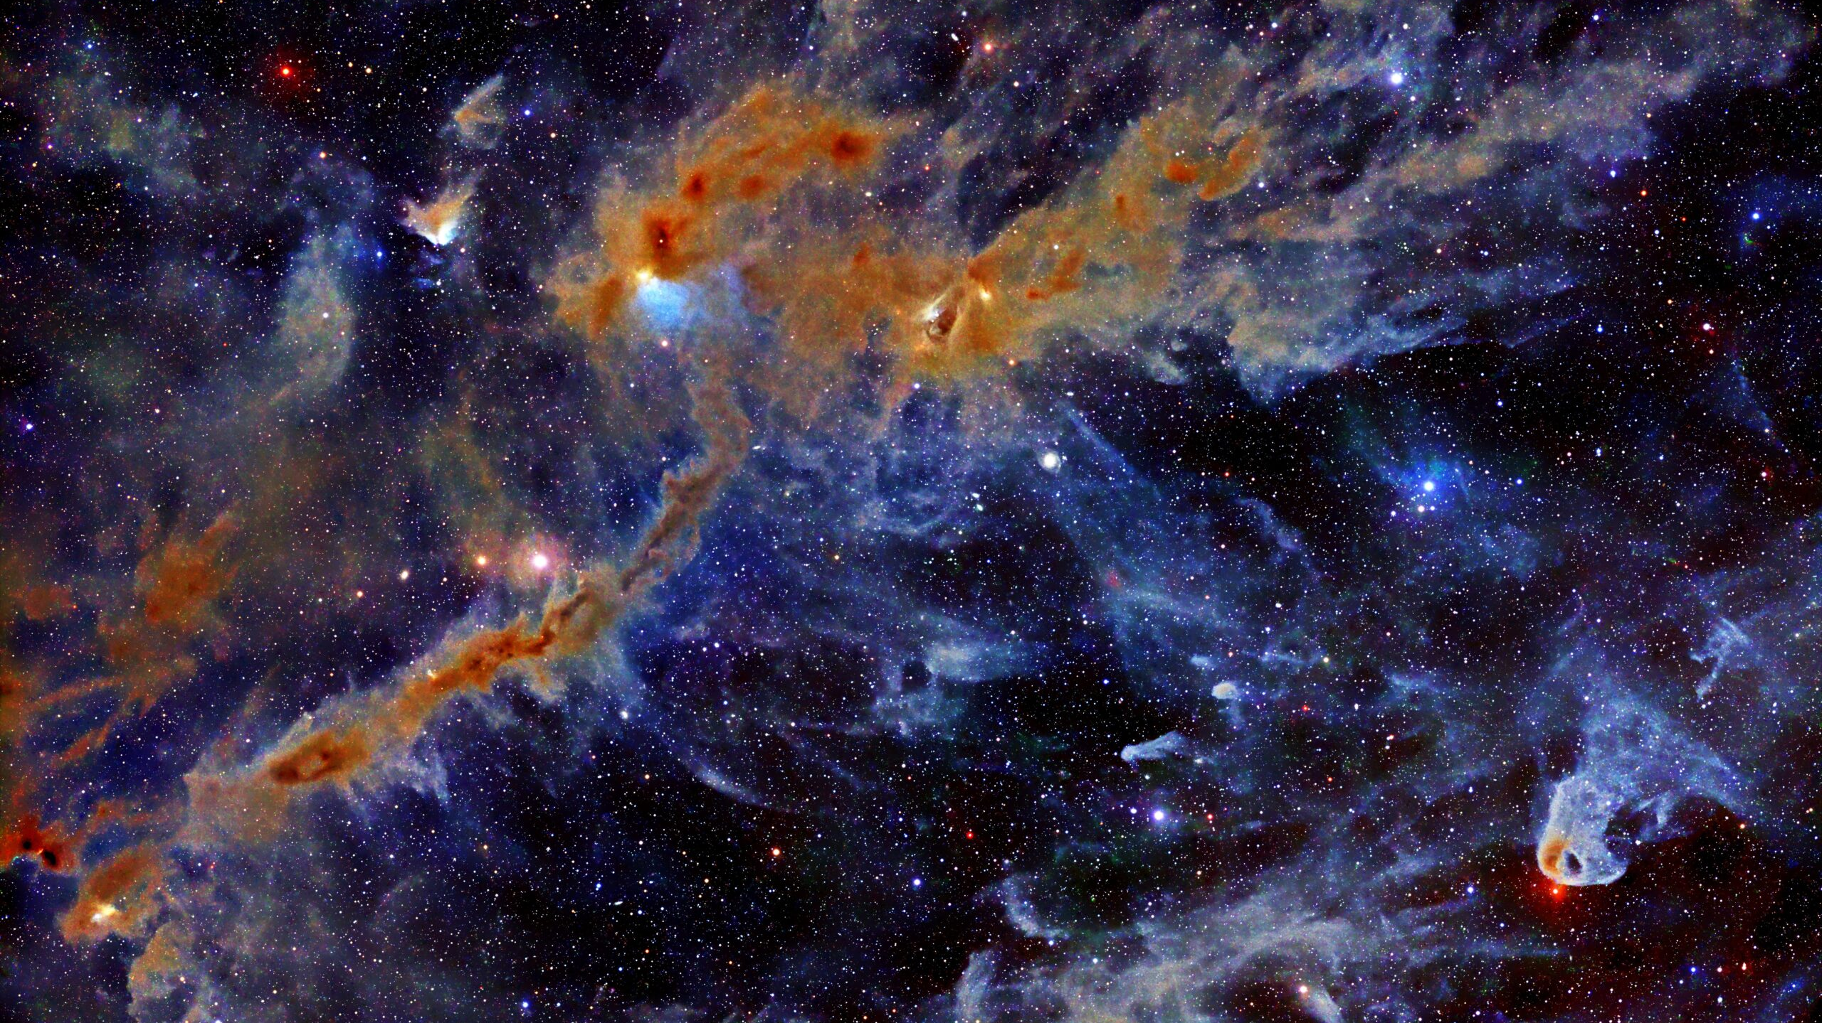



A Survey of NH₂D in Prestellar Cores in the Taurus Molecular Cloud
Aurora Wilde
Mentor: Dr. Yancy Shirley
Image Credit: S. Ziegenbalg

Slide 2
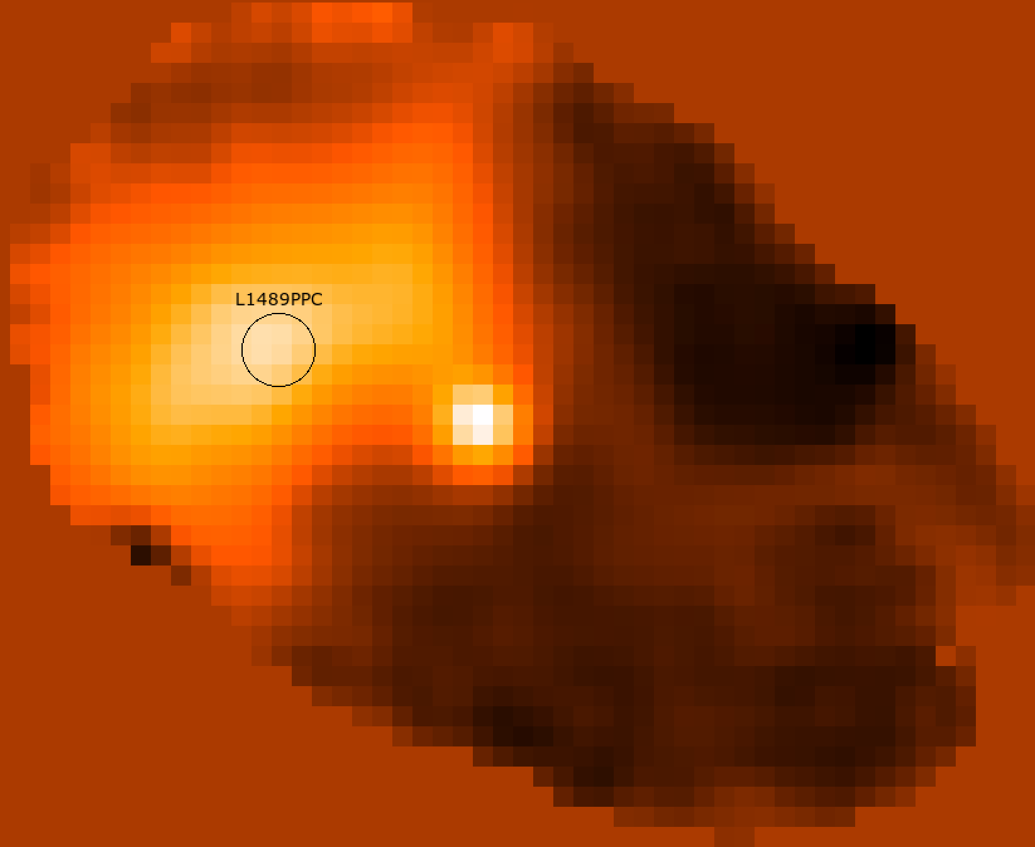
Prestellar Cores
850 μm continuum image of the L1489 region using the SCUBA camera on the JCMT (Submillimetre Common-User Bolometer Array on the 15m James Clerk Maxwell Telescope on Mauna Kea) (Young et al. 2003). The small, bright object to the right is a protostar. The circled area is the FWHM and location of the SMT beam.
Notes:
What is a molecular cloud. prestellar core is the first observable phase of star formation. Point out difference between protostar in scuba image vs prestellar core.

Slide 3
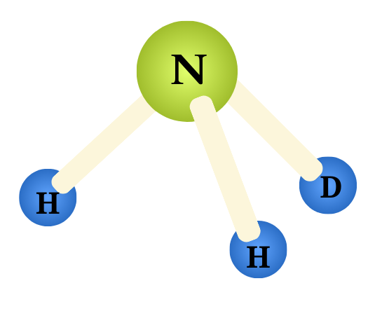
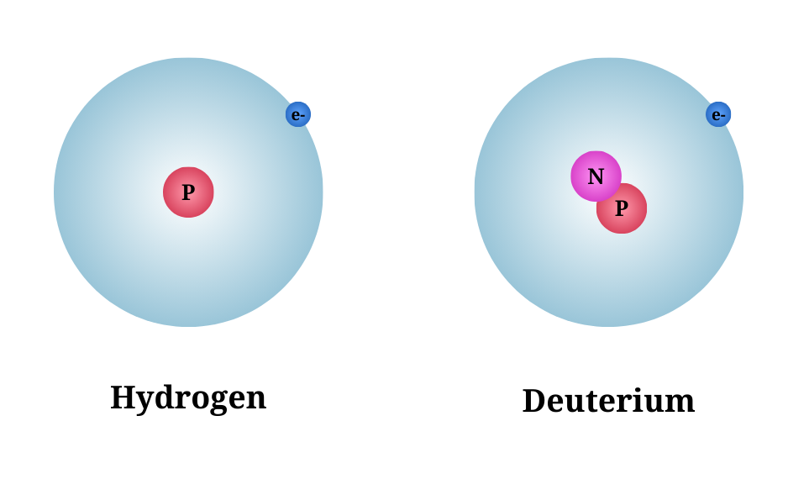
Dense Gas Tracers
Hydrogen
Deuterium
Singly Deuterated Ammonia (NH₂D)
Notes:
Deuterium, dense gas tracer (we care about cold, dense tracers, but there are tracers for lots of environments)

Slide 4
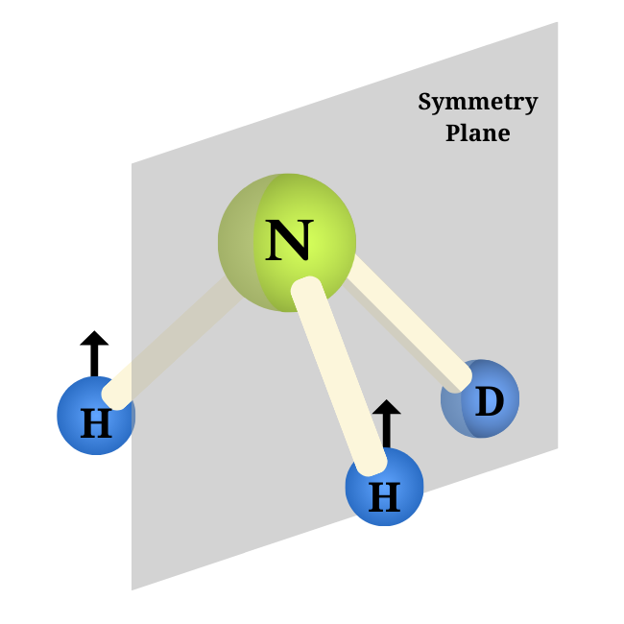
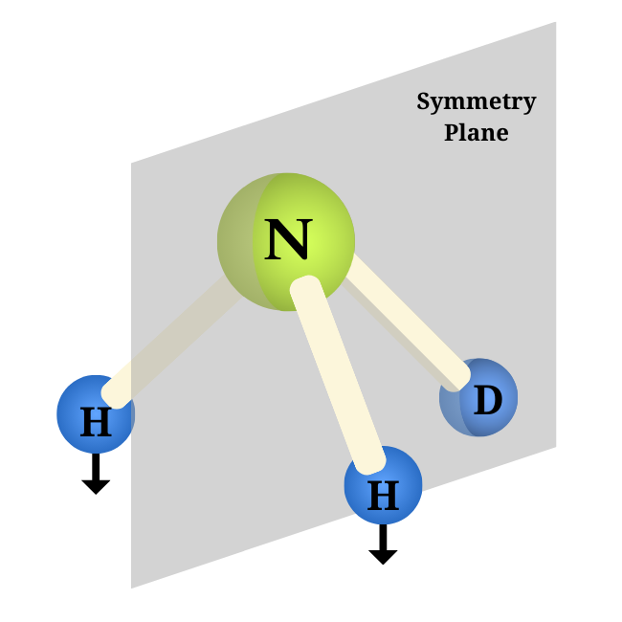

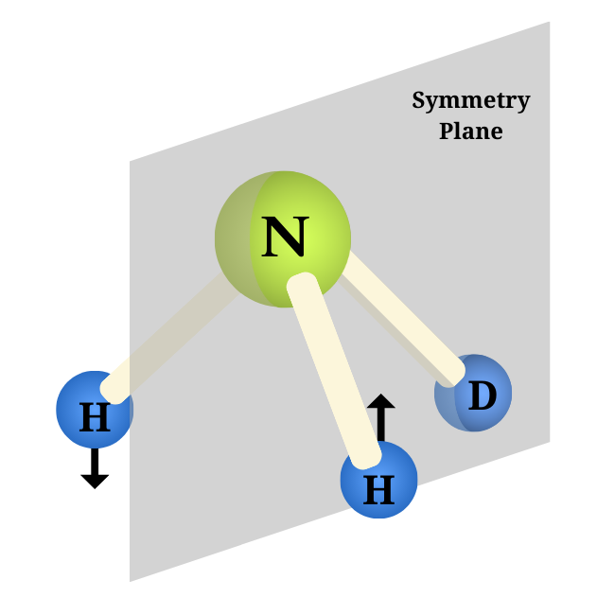
Ortho States:
Para States:
-
+
Notes:
Explain symmetry plane, explain how all ortho states are symmetric and para is antisymmetric. Because there are three states to one para state, if we are working with pure statistics, there should be 3:1 ortho to para molecules in a prestellar core. rotational trans are either ortho or para

Slide 5
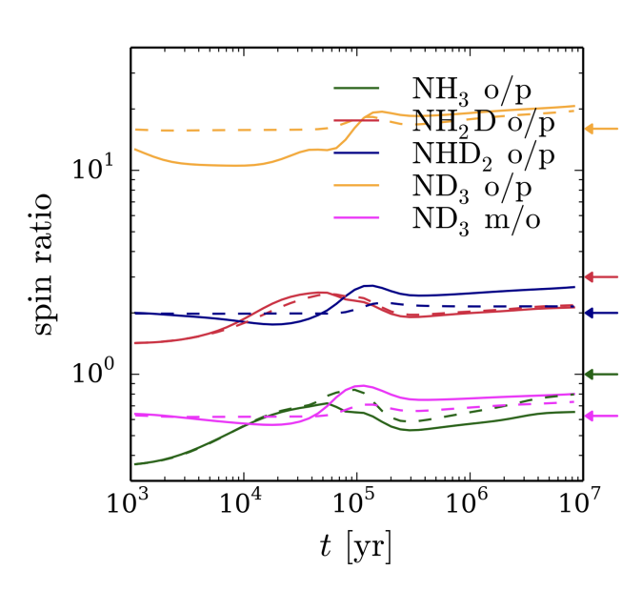
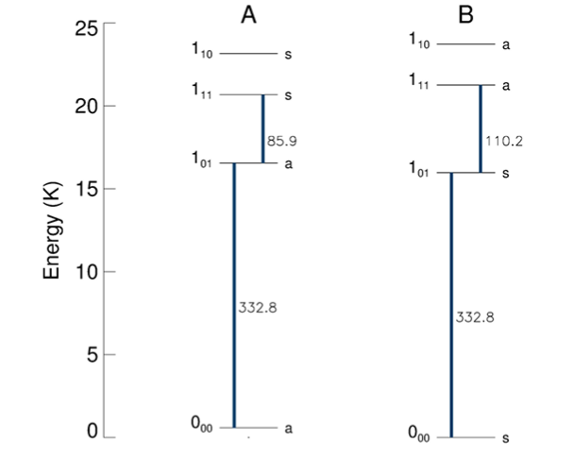
Goals
ortho
para
332.781 GHz
332.882 GHz
Chemical model predictions of the ortho/para ratio evolution of ammonia isotoplogues for a prestellar core with a density of 10e5 cm−3 (Sipilä et al. 2019).
Energies of the lowest rotational levels of NHD2 (Harju et al. 2017).
Notes:
Explain difference between spin scrambling and proton hop. We want to find out which it is because if it is spin scrambling, it will be a useful way to determine how old a core is. We like this molecule because the frequencies are really close to each other, so we can observe at the same time which removes a lot of systematic error.

Slide 6
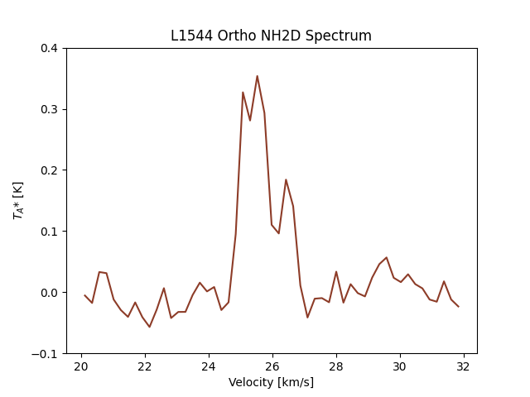
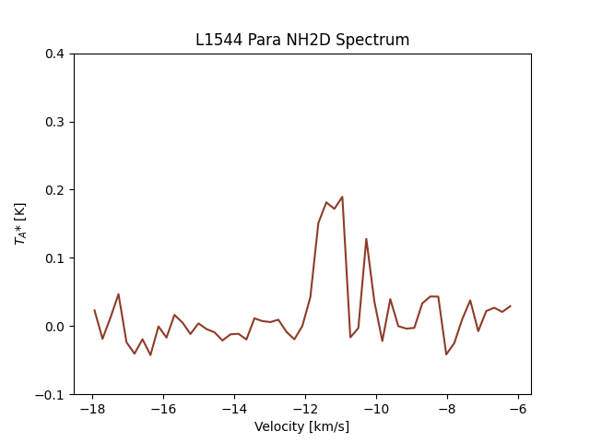
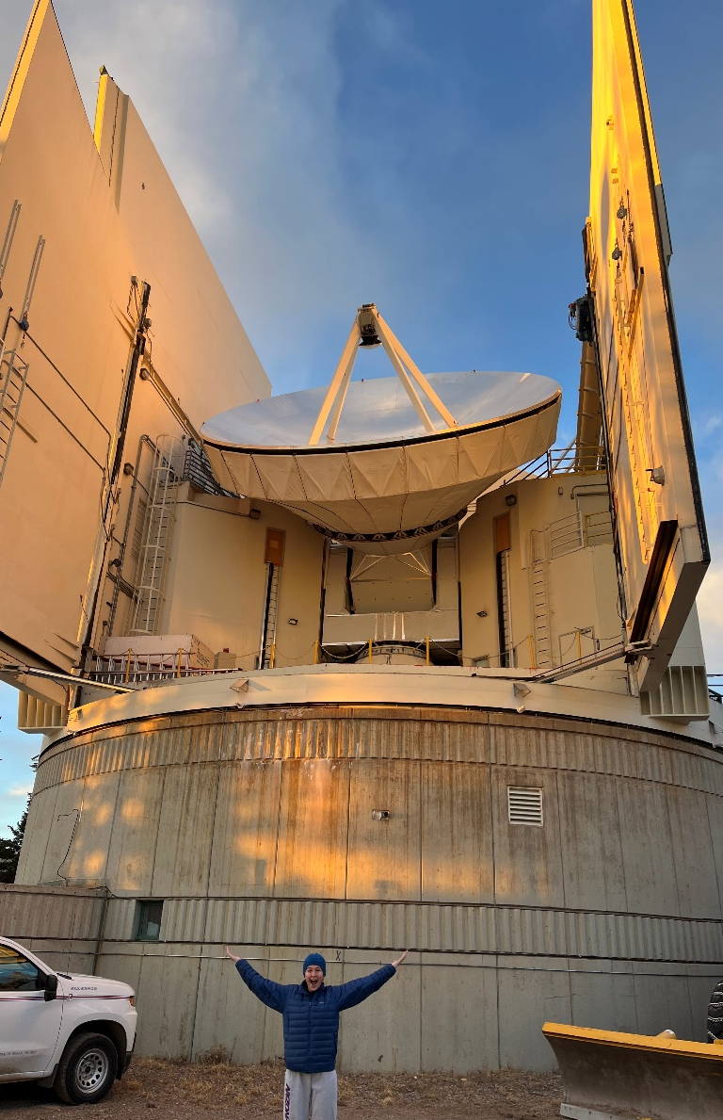
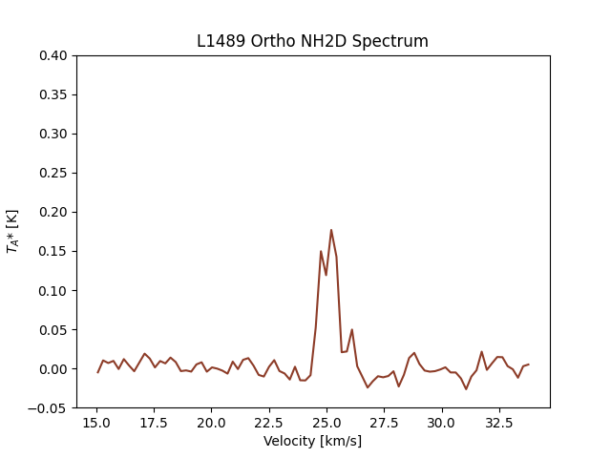
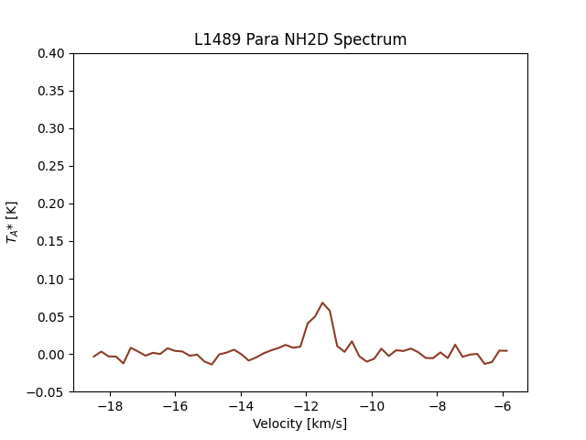
L1544 Ortho
L1544 Para
L1489 Ortho
L1489 Para
Notes:
We observed at the smt! These are the spectra we got for two of our strongest cores. Point out that the peaks are at ~0.3K, hence the long integration time. It is amazing that we can see this at all- super cold.

Slide 7
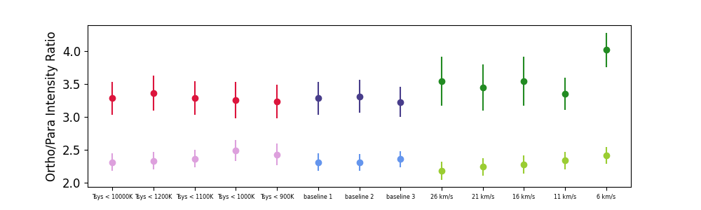
Vpol vs Hpol
Vpol
Hpol
Tsys Upper Limit
Baseline Order
Baseline Range Width
We were unable to explain differences between the polarizations of the telescope.
Notes:
Hpol has a vignetting issue that we know about, but the lower ratio and smaller error bars are concerning. We tried lots of different variables to see if we could constrain why hpol was so different than vpol and we were unable to find something.

Slide 8
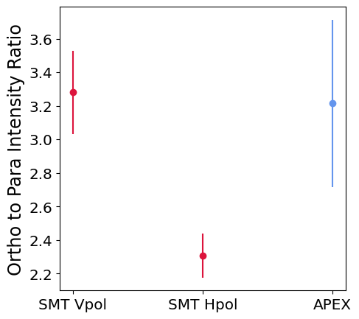
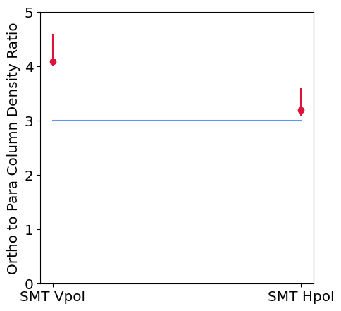
Conclusions
Statistical Ratio (Proton Hop)
Spin Scrambling
Column density ratios obtained from RADEX models are not consistent with either chemical model.

Slide 9
Thank You!
Image Credit: S. Ziegenbalg

